Slide 1

Big Mountain Resort
Increase Revenue & Cut Costs

Slide 2
Problem
How do we increase revenue and cut costs without undermining ticket price? Can we support a higher ticket price?
Big Mountain has 105 trails and about 350,000 visitors yearly
Newly installed chair lift increased operational costs ($1.5 million)

Slide 3
Recommendation & Key Findings
Current ticket price is $81
Modeling supports a ticket price of $95.87
Room for price increase
How to support a premium ticket price
Add new chair lift
Add a run
Increase the vertical drop by 150 feet

Slide 4
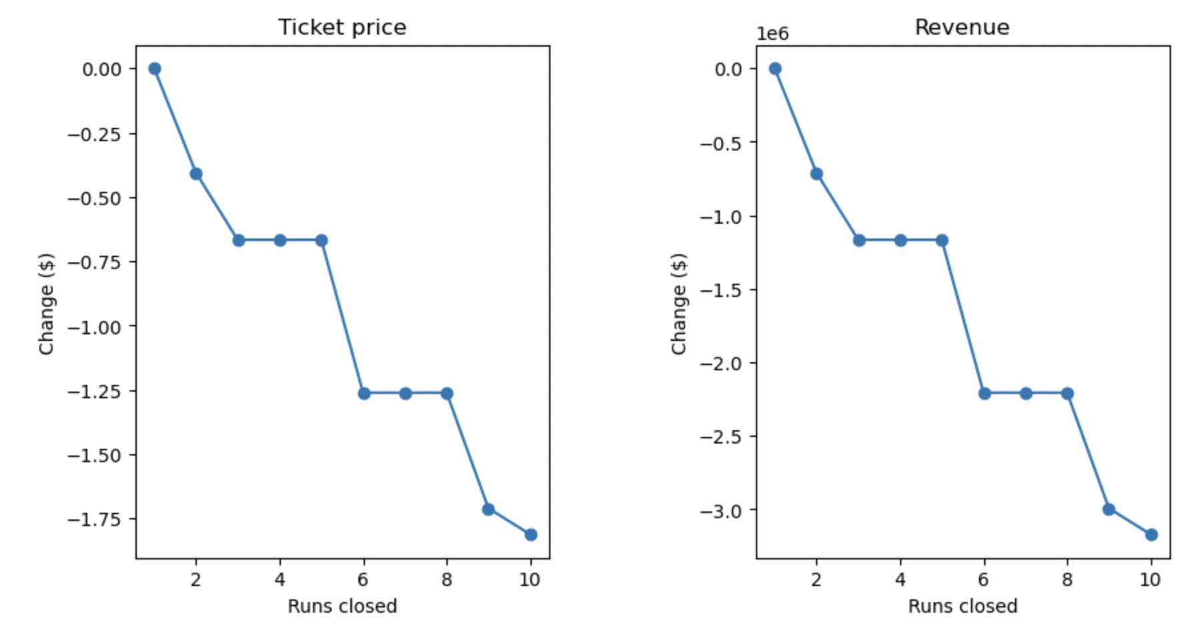
Shows that closing down runs will result in negative support on ticket price
More runs closed causes decreased revenue

Slide 5
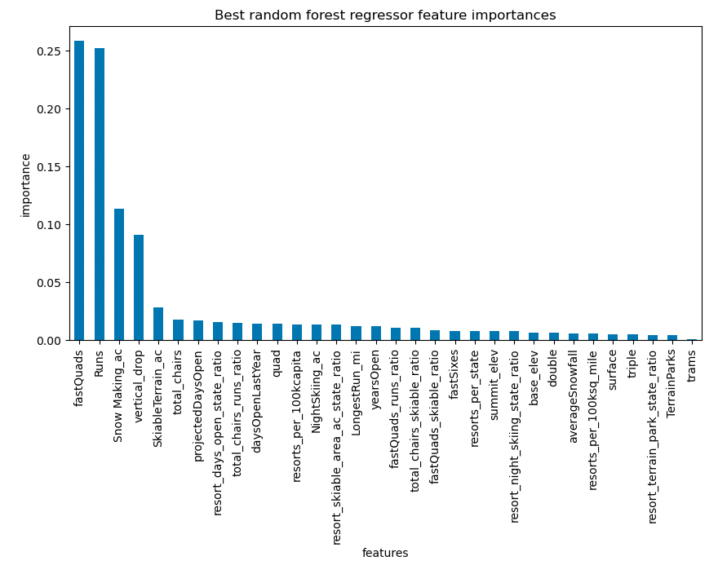
The dominant top four features that influence price are
FastQuads (Fast 4-person chairs)
Runs
Snow Making_ac (Total area covered by snow making machines)
Vertical_drop (Vertical change in elevation)

Slide 6
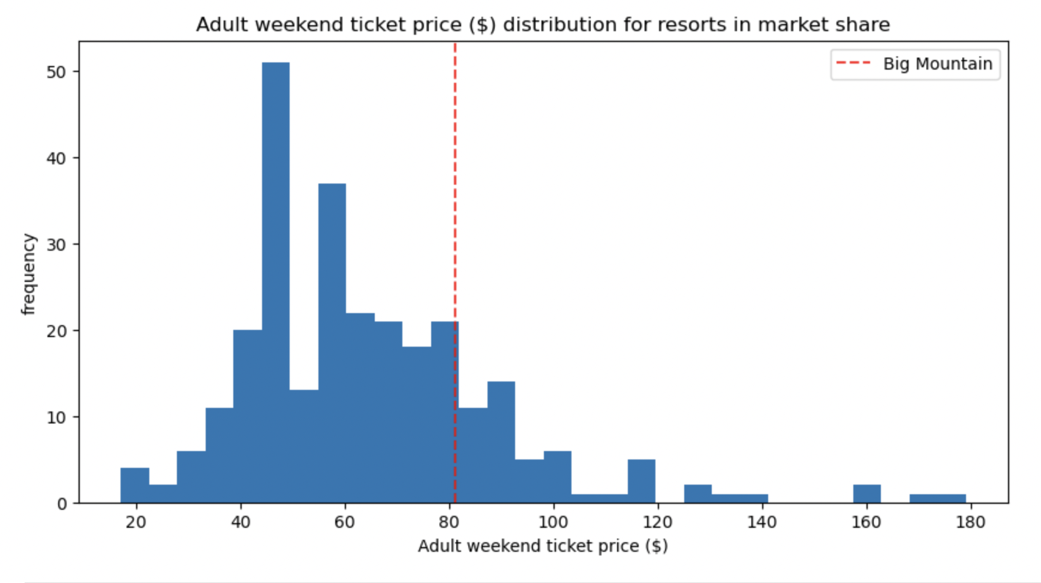
Where Big Mountain resort’s ‘Adult Weekend’ ticket price stands relative to resorts in the United States
Big Mountain is closer to the right-side of the distribution

Slide 7
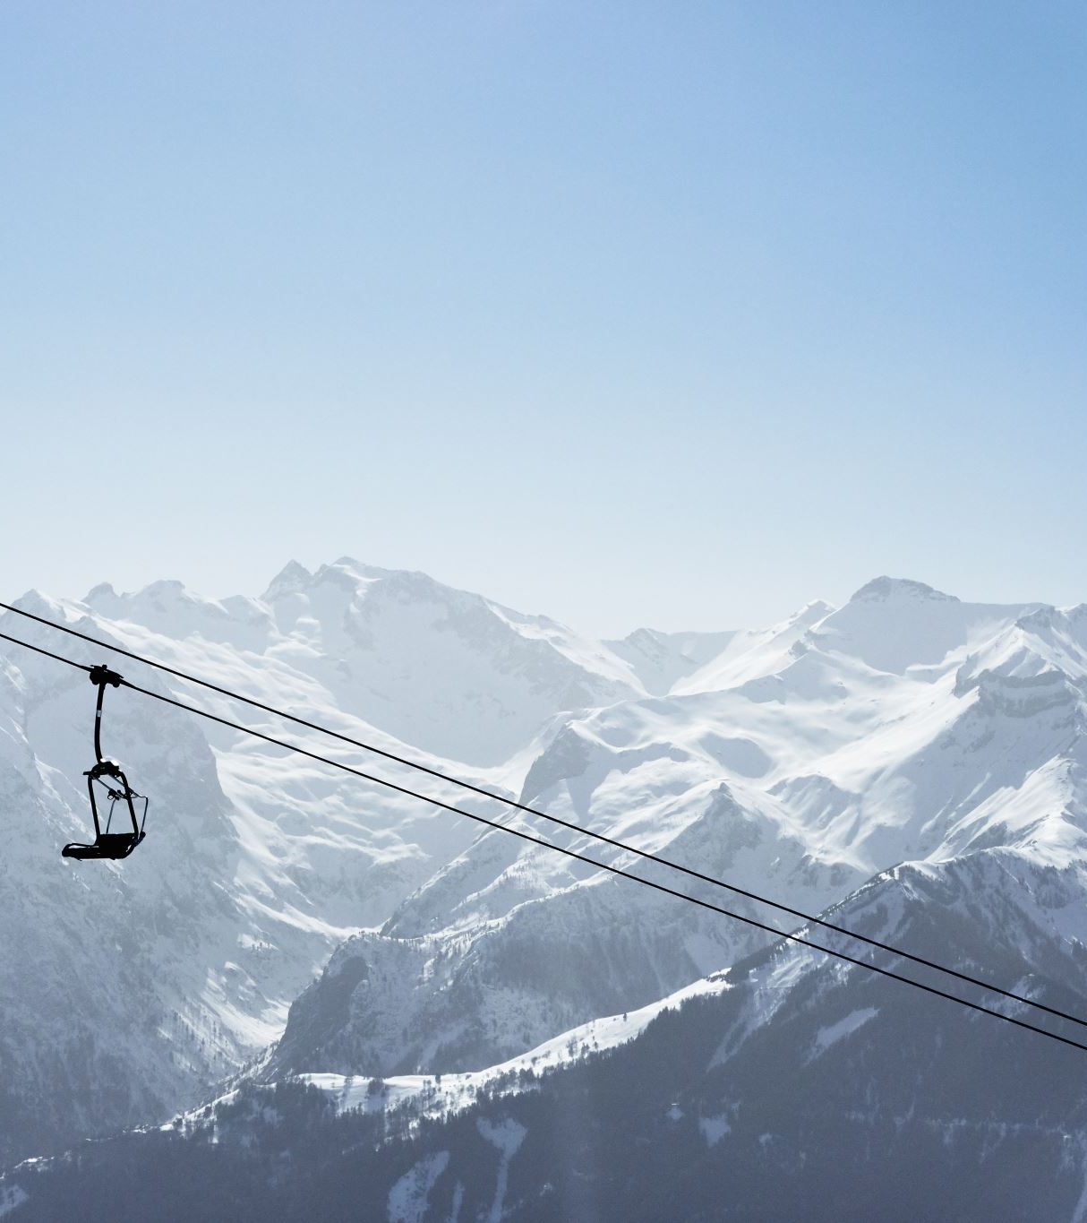
Conclusion
Big Mountain’s facilities support a higher ticket price
Raise the ticket price to $95
Support the premium price by enhancing the facility
Adding a new chair lift
Adding a run
Increase the vertical drop by 150 feet
Big Mountain has a relative higher ticket price compared to other resorts
Be cautious with the increased ticket price

